Slide 1
A Disability Justice Approach To Disaster Assistance
Reimagining How We Prepare for, Respond to
and Recover from Disasters, Humanitarian Crises
& Other Emergencies
Facilitated by
Justice Shorter
& Valerie Novack
Notes:
Take a few moments:
What feels uncertain to you in your organization now and over the next two years?
What have you, your team and the organization as a whole done to manage it?

Slide 2
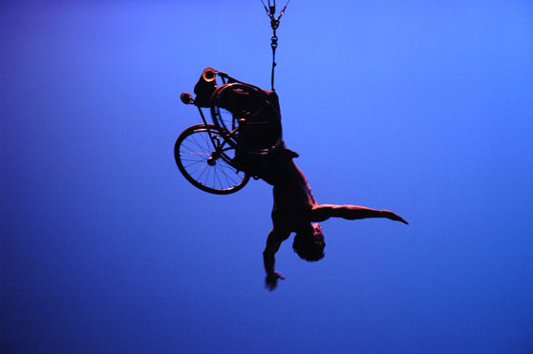
Sins Invalid
Disability justice is a framework coined by a group of queer, disabled women of color that were connected through Sins Invalid, a US-based performance project that incubates and celebrates artists with disabilities, centralizing artists of color and queer and gender-variant artists as communities who have been historically marginalized.
Disability justice recognizes the complexities of multiply marginalized disabled people and aims to be holistic in by recognizing these complexities.
Sins Invalid has created 10 Principles of Disability Justice that, when applied to your work, can help to create a more inclusive, and aware, justice-based response.

Slide 3
Starter Stats
Racial disparities in response:
Pandemics such as H1N1: Indigenous peoples mortality rate was 4 times higher than other groups.
Blacks had rates of 10.9/100k, Latinx 8.2/100k, and whites 3.0/100k.
Lack of non-English options was noted in studies after Hurricane Ike and Katrina as a major factor in non-English speakers access to information on the event and how to respond.
Lower income individuals are at greatest risk when disaster hits. Due to racial disparity in pay this is disproportionally people of color where Black men made $15 hourly average and Hispanic men $14 hourly average to a white man's $21 hourly average as of 2015.

Slide 4
Starter Stats (continued)
Institutionalization:
NCD reports several years of decline in Louisiana IDD institutionalizations with drastic increase of ICF/IDD following Hurricane Katrina.
Domestic Violence:
In the six month period after Hurricane Floyd hit North Carolina in 1999, the rate of inflicted TBI in children under two showed a fivefold increase in counties severely affected by the hurricane.
Following Hurricane Andrew in Florida in 1992, domestic violence calls to the community helpline increased by 50 percent.
Domestic violence increased by 45 percent in the wake of Hurricane Katrina in 2005.

Slide 5
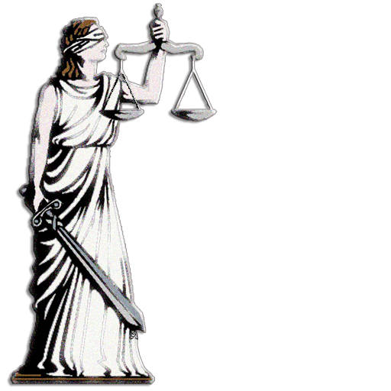
The Legal Lens
ADA Title II
Section 504 of the Rehabilitation Act of 1973
State laws where applicable

Slide 6
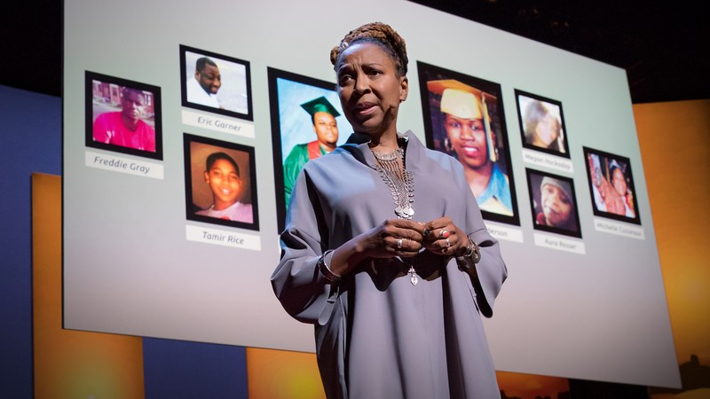
Principle #1 | Intersectionality
Multiple forms of discrimination, experienced by historically marginalized groups in particular, often overlap or intersect in ways that:
Interfere with effective preparedness
Inhibit efficient response
Impede equitable recovery

Slide 7
Actions To Consider
Explore how individuals are impacted by ableism, racism, sexism, classism, ageism, religion, homophobia, xenophobia etc., throughout disasters/emergencies.
Use intersectional approaches to advance operational standards across disaster activities.
Co-design emergency plans alongside historically underserved communities.
Intervene when the intersectional experiences of survivors with disabilities are dismissed or deemed invalid by those providing disaster assistance/emergency services. Acknowledge behaviors such as gas lighting and micro aggressions and their detrimental impact on a survivor’s ability to prepare, respond and recover.

Slide 8
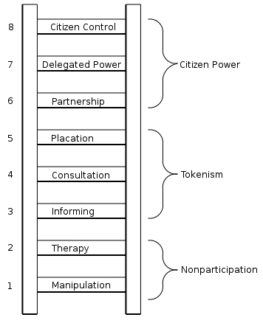
Principle #2 | Leadership By The Most Impacted
Individuals from communities most impacted by disasters serving in decision making positions that shape programs, plans/policies, resources and services.

Slide 9
Actions To Consider
Appoint disaster survivors with disabilities to leadership positions that shape future emergency activities
Invite those most impacted to the planning table as equal partners/contributors
Ensure that those who are most impacted by disasters are at the table not just as storytellers but decision makers
Examine not only the value of work experience but also lived experience when determining which people should be included around decision making tables
Assess which barriers prevent people from communities most impacted by disasters from serving as proactive leaders rather than passive recipients of assistance (i.e. time commitments, training, accommodations, transportation, childcare etc.)

Slide 10
Principle #3 | Anti-Capitalist Politic
The application of American Capitalism has contributed to histories of harm to people and Earth. We must rethink the use and distribution of resources which requires a rethinking of our specific economic system.
Resources, services and other preparedness and response efforts are often linked to wealth and is disproportionately harmful to lower income citizens, including many with disabilities and people of color.

Slide 11
Actions To Consider
Consider how economic development contributes to extreme weather and disaster events such as oil spills, water pollutants, flooding, etc.,
Prioritize rebuilding in underserved communities destroyed by disasters. Focus on including those in low income areas/homeless populations.

Slide 12
Actions To Consider
Address the potential cost prohibitive nature of personal preparedness for members of your community by co-creating individualized plans that are resourceful/realistic.
Determine who is receiving the financial benefits of grants and assistance through public record requests under the Freedom of Information Act (FOIA) or other relevant state statutes. Hold government agencies accountable for addressing inequities in assistance.

Slide 13
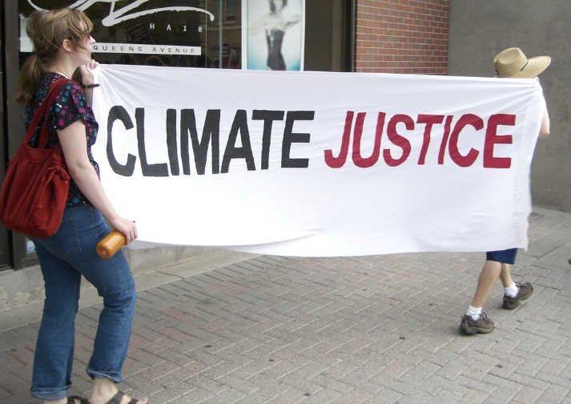
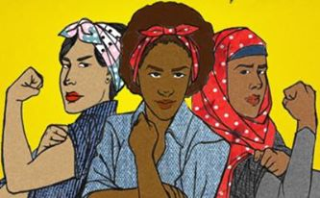
Principle #4 | Commitment to Cross Movement Organizing
Recognizing the whole identities of disaster impacted people with disabilities also connects you to other overlapping issue areas.

Slide 14
Principle #4 (Continued) | Commitment to Cross Movement Organizing
Cross movement organizing helps to make sure organizations that may not traditionally be doing emergency preparedness work, are made aware of certain necessary aspects of inclusive disaster planning, making their movements more educated. Likewise, your organization might not focus on other social movement work, but will gain a better understanding of the needs of diverse groups of individuals from work being done in other spheres.

Slide 15
Actions To Consider
Build multiagency continuity plans to ‘share the load’. Know what problems you are trying to prevent and for which people. Build coalitions that directly partners marginalized communities with disaster leaders/government officials.
Disasters don’t discriminate but environmental barriers and attitudinal biases do create systemic inequality that disproportionately effect individuals with disabilities. Create plans that intentionally prepare regionally across historically underserved groups. These plans must consider the histories of harm present for such communities.

Slide 16
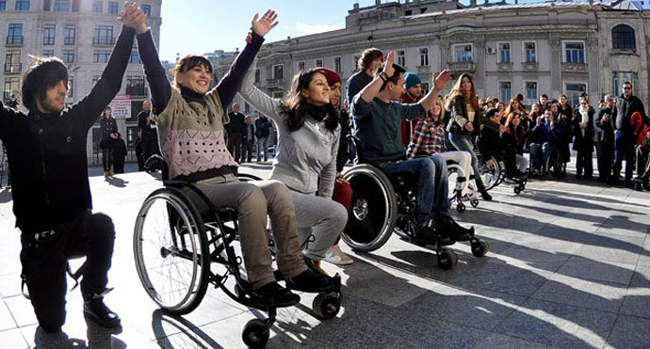
Principle #5 | Recognizing Wholeness
If we can agree that people have inherent worth then all disaster assistance activities should prioritize safety, dignity, accountability, participation and do no harm.

Slide 17
Actions To Consider
Consistently express throughout emergency processes how we intend to make space for survivors to show up as their whole selves without fear of mistreatment
Remain mindful that people with disabilities are also first responders, emergency managers, part of families, in the community, etc.
Utilize the professional/experiential expertise of people with disabilities throughout disasters/emergencies.

Slide 18
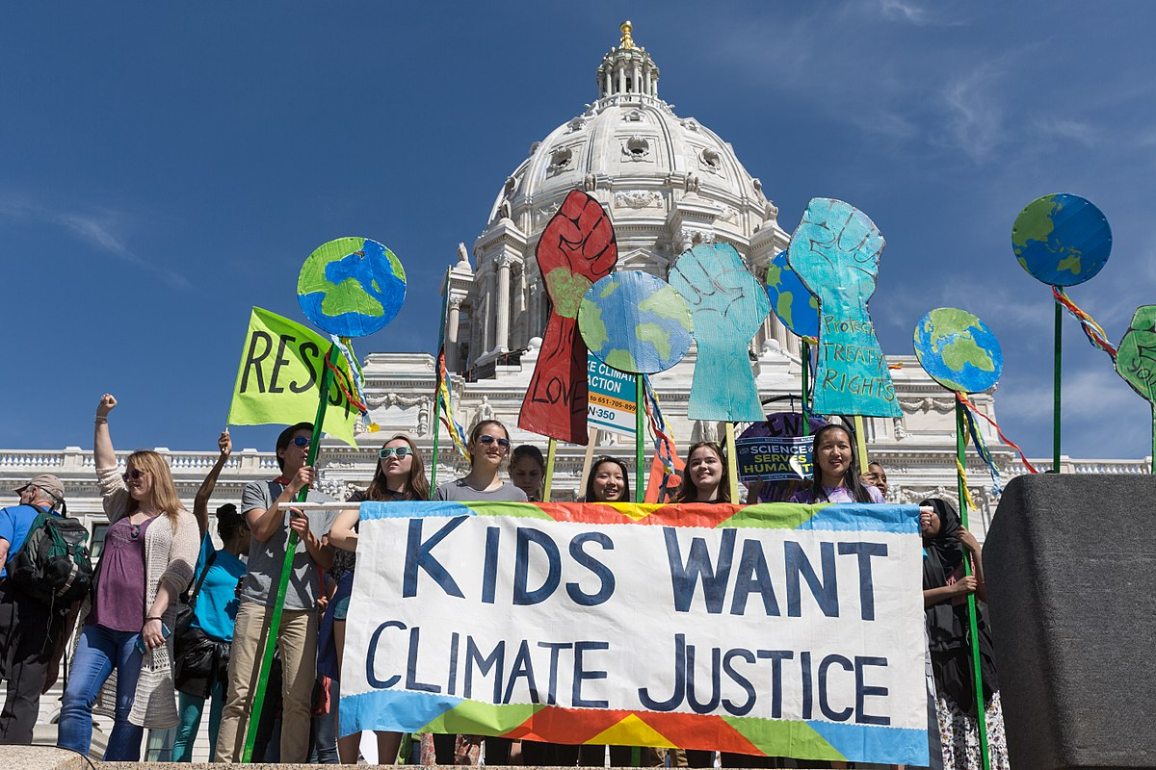
Principle #6 | Sustainability
Sustaining the move towards preparedness and resilience in a way that centers people, communities and body mind needs as a means of effective emergency management.

Slide 19
Actions To Consider
Shape sustainability plans to specifically address the physical, mental and emotional impact disasters have on individuals/communities.
Mobilize mitigation activities that allow us to make connections between Climate Justice and Disability Justice. Examine if environmental racism has caused physical or mental harm to effected communities.
Ensure systemic change by embedding access into processes, programs and policies rather than a one-time approach.
Resilience is rooted in Representation. Center the recovery priorities of those most impacted. Ensure that they also define how long-term success is measured.

Slide 20
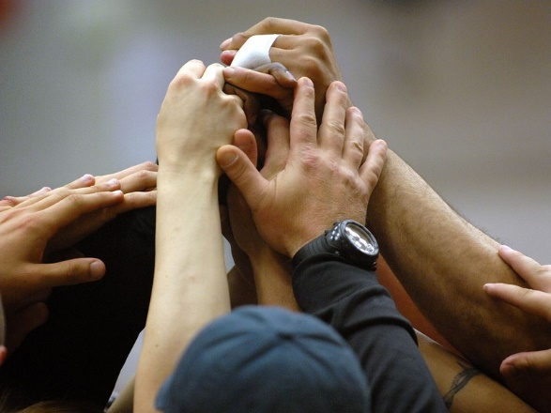
Principle #7 | Commitment to Cross Disability Solidarity
Disability is not a monolith. You may work with a single population, or the loudest voices might primarily be coming from one group, organization, or subset of the disabled population. People have different needs as well as multiple disabilities, working across disability types helps to ensure inclusion in response both for your consumers, and at large.

Slide 21
Actions To Consider
Attend events, circulate resource material and support initiatives that center individuals with different types of disabilities.
Agree on a solidarity strategy between diverse organizations aimed at coordinating support for disaster survivors with disabilities to receive equal access to emergency resources/services.
Address inequities that effect some people in the disability community and not others by explicitly assessing accommodation/inclusion gaps observed throughout previous disasters.

Slide 22
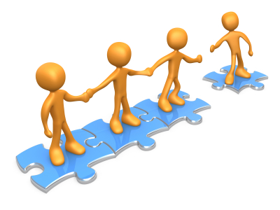
Principle #8 | Interdependence
No one person, organization, or outcome is independent. We are dependent on others whether that is personally or in business. Recognizing this interdependence and pushing against the myth of independence, brings further dignity to those that are openly dependent for certain things.
Interdependence is critical in preparedness and response. Making partnerships, planning as communities and regions, and leveraging strengths and resources are ways to create community driven preparedness that benefits everyone.

Slide 23
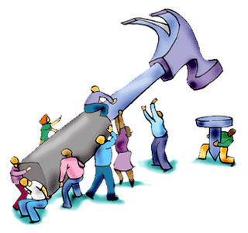
Actions To Consider
Develop an understanding of the collective/individual needs of those around us including community, non-profit, government and charity through direct outreach/engagement. Utilize these relationships to rapidly resolve challenges/conflicts.
Preserve the dignity of survivors with disabilities by acknowledging the universal value of interdependence during disaster response/recovery.

Slide 24
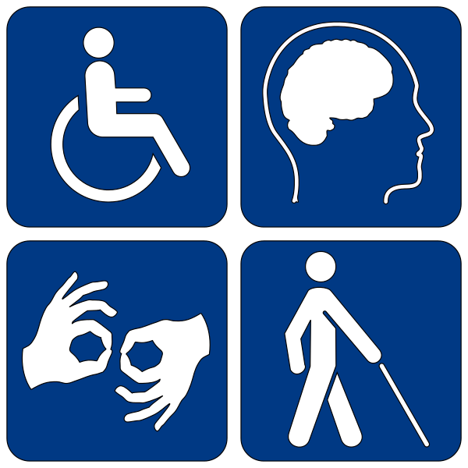
Principle #9 | Collective Access
Collectively meeting access needs while simultaneously respecting independence and self-determination when planning for disasters/emergencies

Slide 25
Actions To Consider
Invite disabled people to partner in creating disaster spaces useable by all.
Go to a variety of disability centric groups in impacted areas to determine what access in the community is lacking.
Seek out access suggestions prior to finalizing emergency oriented events/activities. Expressly mention which accessibility considerations/accommodations are readily available when publicizing events/programs to prospective attendees.

Slide 26
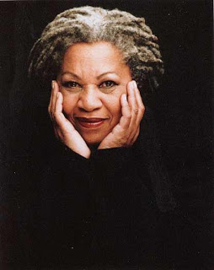
Principle #10 | Collective Liberation
Nothing about us without ALL of us.
“The function of freedom is to free someone else, and if you are no longer wracked or in bondage to a person or a way of life, tell your story. Risk freeing someone else.”
– Toni Morrison
“None of us are free until we are all free.”
– Dr. Martin Luther King

Slide 27
Actions To Consider
Advocate for adequate disaster/emergency evacuation plans for prisoners and detainees with disabilities.
proactively work to prevent and monitor/track involuntary institutionalizations after disasters.
Remain vigilant of how displacement and a lack of housing after disasters may increase rates of human trafficking. Examine the effects of this in relation to women and children with disabilities. Consider protection and prevention measures that we can collectively implement to address this issue.

Slide 28
Contact Us
Justine “Justice” Shorter
Disaster Protection Advisor
National Disability Rights Network
Justine.Shorter@ndrn.org
Phone: 202-880-2435
Valerie Novack
2019 Portlight Fellow
Center for American Progress
vnovack@americanprogress.org
Phone: 206-707-3754

Slide 29
Thank You

